Slide 1
NYS GIS Association Annual Meeting
Tuesday, October 21, 2014
4:00 – 5:30 PM
Skaneateles, New York

Slide 2
NYS GIS Association Annual Meeting
Welcome
GAC Update
Association Budget
Approval of Annual Meeting Minutes from 2013
Association Accomplishments in 2014
Thank Yous
Committee Reports
Election Results Announcement
Installation of New Leadership Team
Open Discussion About Association Strategy and Future Directions

Slide 3
Geospatial Advisory Council (GAC) Update
Mike Ross, Council Representative

Slide 4
Association Budget Christa Hay, Treasurer

Slide 5
Accomplishments in 2014
Creation of New Committees
Awards
Government
External Development
Expansion of Website and Social Media Presence
Creation of Marketing Plan / Higher Education Sustaining Membership
Coordination/Interaction with GAC
Grew Membership to Over 650
Organized 9 High-Quality Webinars, with More to Come this Year!
Increased Support to and Interaction with Regional Groups
Continued to Monitor Legislative Issues Impacting GIS
Organized an Amazing Geospatial Summit

Slide 6
Thank Yous
Al Leidner
Past President
Leadership for the past 2 years
Will stay on as Regional Committee Chair/Co-Chair
Bill Johnson
Summit Committee Chair/Co-Chair
Chaired committee for all 8 Summits!!
Board Members
Committee Chairs
Committee Members

Slide 7
Committee Reports

Slide 8
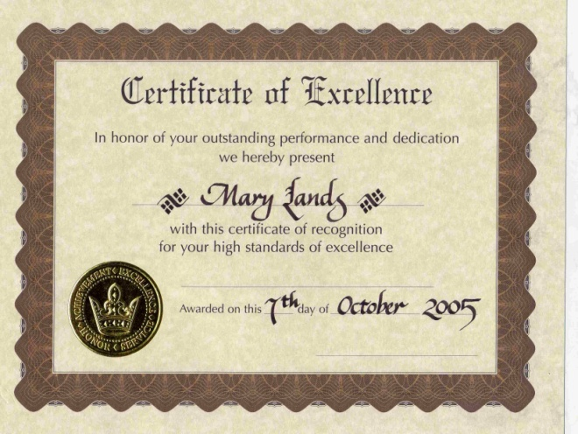
Awards Committee Ben Houston, Chair
6 participating members
2014 Awards program included 3 categories
2015 Awards program will include a new "Applications" category

Slide 9
Communications Committee Carol Zollweg, Chair
Public face of the NYS GIS Association
Website (nysgis.org)
GeoSpatial Summit too!
Support committees and regional groups
Avg 25 posts/month

Slide 10
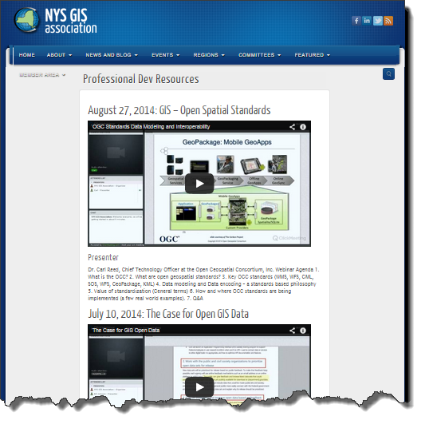
Communications Committee Carol Zollweg, Chair
Professional Development
Recorded webinars
Membership
Online database

Slide 11
Communications Committee Carol Zollweg, Chair
Email
New this year: MailChimp

Slide 12
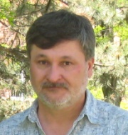
Communications Committee Carol Zollweg, Chair
Danielle Bargovic
Don Meltz
Jake Needle
Sheri Norton
Michael Fitzgerald
Cattyann Campbell
Vijay Sambandhan
nysgeo@gmail.com

Slide 13
2015 NYGeoCON!
October 28-30, 2015
Albany Hilton
2015 NYGeoCON Committee

Slide 14
NYGeoCon 2015 Committee Bruce Oswald, Chair
2015 NYGeoCON Committee
John Barge, Adirondack Park Agency
Mickey Dietrich, Tug Hill Commission
Christa Hay, CT Male
Eric Herman, Thruway Authority
Bill Johnson, NYS Information Technology Service
Susan Nixson, City of Ithaca
Bruce Oswald, Oswald Associates, Committee Chair
Lindi Quackenbush, SUNY ESF
Tom Sears, Steuben County
Cindy Sherwood, Delaney Meeting & Event Mgt.
We could use 1 or 2 more…how about you?

Slide 15
NYGeoCon 2015 Committee Bruce Oswald, Chair
2015 NYGeoCON
Dates 10/28-10/30 – SAVE THE DATES!
Location Albany Hilton
Evaluated last year’s conference & feedback from attendees & sponsors
Contracted with DMEM
Established a budget, planning schedule & conference agenda
Developed sponsor packages & save the date post card
Looking for ideas for workshops, keynotes, & interesting speakers! (bruce.oswald@gmail.com)

Slide 16
Education Committee Andy Mendola, Chair
Committee Members
Andy Mendola, Pictometry, Chair
Eileen Allen, SUNY Plattsburgh
Alexander Chaucer, Skidmore College
Ann Deakin, SUNY Fredonia
Susan Hoskins, Cornell University
Mike Jabot, SUNY Fredonia
Jim Kernan, SUNY Geneseo
Jonathon Little, Monroe Community College; New York Geographic Alliance
Lisa Matthies-Wiza, Erie County Environment and Planning; Erie Community College
Susan Nixson, City of Ithaca; Ithaca College
Rich Quodomine, NYS Department of Transportation
David Stern, Nassau Community College
Pete Walsemann, Carthage High School
Amy Work, Institute for the Application of Geospatial Technology

Slide 17
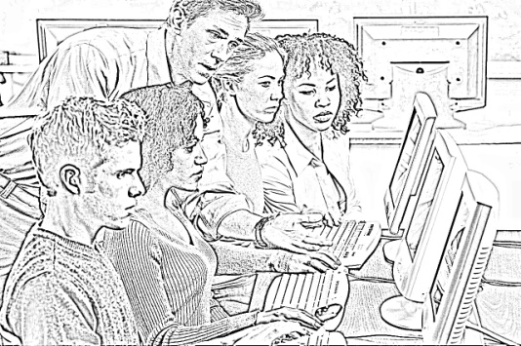
Education Committee Andy Mendola, Chair
Education Committee Efforts
Higher Education Sustaining Membership
GeoFest Conference 2014
NYS Esri K-12 License
Strengthening Community College Programs
Geotech Center webinar
GeoMentoring
Supporting GIS Day November 19th, 2014
Pictometry Online Webinar for educators

Slide 18
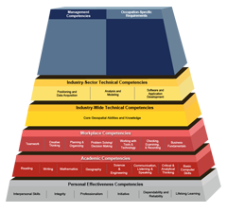
Education Committee Andy Mendola, Chair
Education Committee Plans
Increase Higher Education Sustaining Membership
Increase access to NYS Esri K-12 License
NYGA Collaboration
GeoTech Center Collaboration
Increase high school programs
Pictometry Online webinar for educators

Slide 19
External Development Committee Rich Quodomine, Chair
Current Members
Alan Leidner, Booz, Allen, Hamilton
Bev Corwin, Program Director, AFCOM
Purpose
To lead and coordinate outreach to external partners for the purpose of better coordinating activities, education and training and possible sponsorships

Slide 20
External Development Committee Rich Quodomine, Chair
Current Activities
Gathering probable new organizations to make formal relationship with
Grow the committee

Slide 21
Government Committee Julia O’Brien & Mike Ross, Co-Chairs
Members
Eric Herman (NYS Thruway)
Sheri Norton (Ontario County)
Abrom Shepard (FEMA SRO)
Dennis Wischman (NYS DEC)

Slide 22
Government Committee Julia O’Brien & Mike Ross, Co-Chairs
Mission
To engage government entities on behalf of the NY State GIS Association to promote and influence GIS employment standards and education in the public sector, and to elevate GIS and GIS professionals in government service

Slide 23
Government Committee Julia O’Brien & Mike Ross, Co-Chairs
Efforts in 2013-2014
Collecting GIS titles and qualifications from state, county, local, federal, and GISCI
Building a matrix of titles and qualifications as a tool for comparison
Gathering facts on how the new State IT titles will work
Developing a FAQ sheet on the Civil Service exams, and how they are similar or different between State and Local governments

Slide 24
Legislative Committee Joe Jones, Chair
Mission – To protect and promote the interests of the GIS community by reviewing proposed legislative initiatives and providing input
History of dealing with legislation proposed by the NYS Assoc. of Professional Land Surveyors (NYSAPLS)
Current legislation doesn’t recognize the ability of GIS professionals to make maps
Actively communicate with legislative staff, NYSAPLS, the NYS Professional Engineers Society and NYS Dept. of Education

Slide 25
Legislative Committee Joe Jones, Chair
2014 Legislative Session
Re-introduced by Senator LaValle and Assemblywoman Glick (S04827 & A07486) (Same as 2013 bills)
Referred to Higher Education Committees
2015 Legislative Committee Actions
Hold discussions with NYSAPLS
Identify actions they are pursuing
Negotiate changes in bill language
Hold discussions with NYS Dept. of Education, PE Society, & the American Society of Landscape Architects as required

Slide 26
Membership Committee Razy Kased, Chair
650+!
Membership Outreach/Renewal Efforts
Membership Feedback
Membership Future Training Survey
Membership response rate: 30%
Members Training Session Topics:
Desktop/Web GIS
Python/Programming/Mobile App Development
GPS/Field Data Collection
Non-technical topics related to Geospatial Field
Membership Professional Affiliation Groups Survey
Membership response rate: 25%
Membership Company/Organization Type
State/Local Government: 48%; Private Firm: 29%
Field in which GIS is utilized: Transportation; Marketing/Business; Emergency Management
Looking Forward to 2015; Thank You, Board; Committee; Members
Contact: rkased@gflrpc.org or call 585-454-0190 x20
Notes:
Katherine Barnes presenting

Slide 27
Membership Committee Razy Kased, Chair
Committee Members
Razy Kased, Genesee/Finger Lakes Regional Planning Council, Chair
Katherine Barnes, NYS DEC
Christa Hay, CT Male
Zachary Lehmann, Great Ecology
Timothy Michalowski, Abt SRBI, Inc.
Sheri Norton, Ontario County
Carol Zollweg, Bergmann Associates

Slide 28
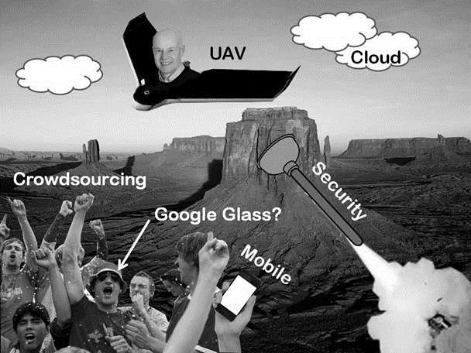
Professional Development Committee Mickey Dietrich, Chair
Where’s Bruce?

Slide 29
Professional Development Committee Mickey Dietrich, Chair
Committee Members
Mickey Dietrich, NYS Tug Hill Commission, Chair
Ann Deakin, SUNY Fredonia
Garvis DiLauro, FPM Remediations
Christa Hay, CT Male
Alan Leidner, Booz Allen Hamilton
Dale Morris, Erie County
Rich Quodomine, NYS Department of Transportation
Heather Weller, Washington County
Amy Work, Institute for the Application of Geospatial Technology

Slide 30
Professional Development Committee Mickey Dietrich, Chair
Webinars
“Demystifying Parliamentary Procedures”
January 9th, 2014
Bill Johnson, Geographic Information Officer, NYS Office of the CTO
“Thoughts on the Direction of Technology and GIS”
January 30th, 2014
Bruce Oswald, Oswald Associates
“Applying for a GIS Grant from the New York State Archives”
February 19th, 2014
Geof Huth, Director, Government Records Services, NYS Archives
“Rockland County GIS”
May 8th, 2014
Douglas J. Schuetz, GIS Director, County of Rockland – Department of Planning
“Utilizing GIS in Precision Agriculture”
June 19th, 2014
Jill Stanford, Spatial Data Architect, John Deere

Slide 31
Professional Development Committee Mickey Dietrich, Chair
Webinars (Cont.)
“The Case for GIS Open Data”
July 10th, 2014
Bill Johnson, Geographic Information Officer, NYS Office of the CTO
“GIS – Open Spatial Standards”
August 27th, 2014
Dr. Carl Reed, Chief Technology Officer, Open Geospatial Consortium, Inc.
Academic Webinars
“Pictometry & POL for Educators Webinar”
March 11th, 2014
Andy Mendola, Education Program Manager, Pictometry
“Revitalizing Community College GIS Programs”
September 11th, 2014
Vincent A. DiNoto, Jr., Director, PI GeoTech Center

Slide 32
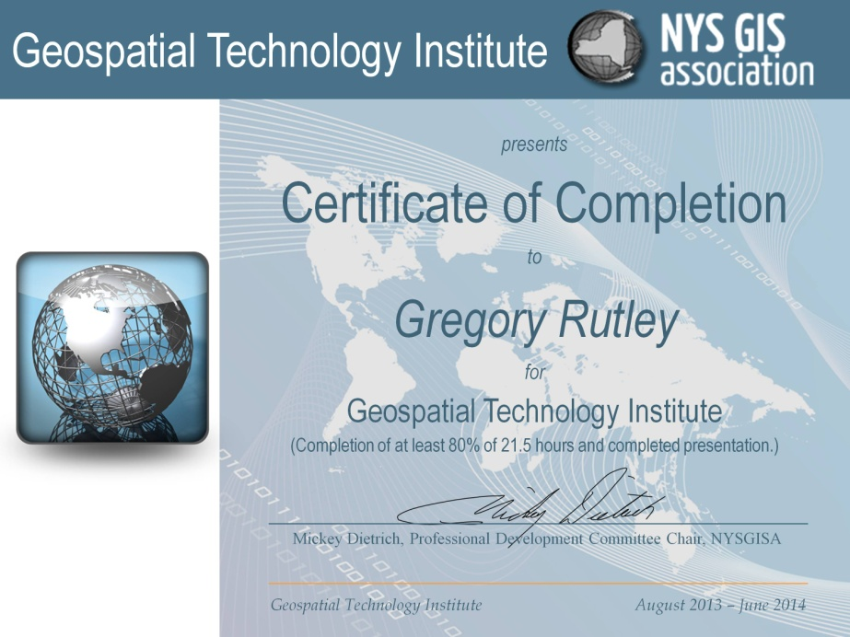
Professional Development Committee Mickey Dietrich, Chair
Geospatial Technology Institute
“Opening Remarks”
Alan Leidner, President of NYS GIS Association
“State Government”
State GIS Advisory Group
Frank Winters, NYS ITS GIS Program Office
“Mobile Data Collection”
Jeff Barth, NYS DOT
Mickey Dietrich, NYS Tug Hill Commission
Bryan McBride, CHA Companies
Scott Whitaker, Jefferson County Highway
“Environmental/Natural Resources”
Dick McDonald, NYS DEC
Brent Kinal, iMapInvasives
Elysa Smigielski, SUNY ESF Grad Student
Eric Herman, NYS Thruway Authority
“Agriculture”
Rory Paul, Aerial Volt Robotics
Patty Ritsow, Agricultural Consulting Services
“Presentations”
Russ Brownell, Lewis County, “Economically Distressed Areas”
Star Carter, DANC, “Thompson Park Zoo Map”
Gregory Rutley, NYS DEC, “Data Driven DEC Public Web Pages”

Slide 33
Professional Development Committee Mickey Dietrich, Chair
Potential/Future Webinars
PowerPoint & Presentation
Tips on putting together a successful PowerPoint and best practices when presenting.
Mobile App Development 101
Looking into a webinar similar to the python training webinar that was run in the past, but on mobile app development. Looking at maybe having one on Leaflet.
Radio Frequency Data Collection from NFL Football Players
The use of radio frequency to track football players speeds, routes, etc. Eventually giving fans more hands on information at stadiums.

Slide 34
Regional Coordination Committee Al Leidner, Chair

Slide 35
Regional Coordination Committee Al Leidner, Chair

Slide 36
Regional Coordination Committee Al Leidner, Chair
Accomplishments 2013 – 2014
Expanded the number of regional organizations represented by POCs to more than twenty
Held 3 POC conference calls to discuss priorities
Committee participated in review of open data and OGC procurement policy papers
Doug Schuetz/Rockland County gave a webinar
Western NYS affiliated with NYSGISA and agreed to a joint dues arrangement
LIGIS signed an affiliation agreement with NYSGISA
Supporting Association recruitment efforts and is promoting Summit attendance
Completed and distributed a Regional Resources Guide
NYSGISA Executive spoke at the regional meetings of GIS SIG, LIGIS, Westchester Users Group and GISMO
GISMO and GISSIG were sponsors of the 2014 GeoCon and NYSGISA sponsored GISSIG and GISMO events

Slide 37
Regional Coordination Committee Al Leidner, Chair

Slide 38
Summit Committee Bill Johnson & Kate Kiyanitsa, Co-Chairs
Committee Members (this has been an outstanding committee!):
Bill Johnson, Co-Chair (stepping down as Chair after this Summit)
Kate Kiyanitsa, Co-Chair (will Chair next Summit in 2016)
Julie Tolar, GISA President
Sue Nixson, GISA President-Elect
Jim Gilmer
Austin Fisher
Lindi Quackenbush
Eric Brady, sponsor outreach
Christa Hay, GISA Treasurer
Dale Morris
Lis DeGironimo
Sheri Norton
Carol Goodman Zollweg, website
(Red indicates members who have served on the Committee for all 8 Summits)

Slide 39
Summit Committee Bill Johnson & Kate Kiyanitsa, Co-Chairs
2014 Summit Highlights
Committee has met weekly since January to plan the event; 38 meetings
Outstanding lineup of speakers (Colin Reilly was very helpful this year)
Very strong attendance (possibly second highest of all 8 Summits?)
Very strong sponsorship (13 bronze, 3 gold, 2 silver)
Event is “in the black” and will generate a net profit to the Association
Schedule of alternating between GeoCon (odd numbered years) and Summit (even years) is good, but some confusion remains with sponsors
Recommend no changes to Summit formula – it works very well as is!
Consider holding 2016 Summit in another area of the state (e.g., New York City)

Slide 40
Election Results Announcement
Susan Nixson, Nominating Committee

Slide 41
Association Leadership Transition
President Elect Mickey Dietrich
Past President Al Leidner
Presidential Transition
President Susan Nixson
Notes:
Special election

Slide 42
Looking Forward
An Exceptional NYGeoCON October 28-30, 2015 at the Albany Hilton
Invitation for additional committee members
Sustainable growth of our membership
Exciting and Informative Webinar Opportunities
Professional Development Committee Co-Chair invitation
Continued Growth of Newly-Formed Committees
Enhanced student support: internships and/or scholarships?
Call for Legal/Attorney guidance
Education Committee Co-Chair position invitation
Educating our leaders: geo-educated Government officials

Slide 43
Open Discussion
Association Strategy & Future Directions

Slide 44
Announcements
Raffle Tickets
Drink Tickets
Meet the Leadership & Committees

