Slide 1
2012 Winter Meeting
NYS GIS
association
Association Winter Meeting March 2012

Slide 2
Agenda
8:30 – Registration/Coffee/Networking
9:00 – Welcome and Introductions
9:15 – Review of Association Activities:
2012 Proposed Surveying Legislation
Professional Development Activities
Conference Committee Updates
Implementing K-12 Education
Tour of new website
10:00 – Discussion on Assisting Members Looking for Jobs
10:15 – Coffee/Networking
10:30 – Presentation on Census Data by Bob Scardamalia
12:00 – Meeting Adjournment
March 2012

Slide 3
Background – Board of Directors
President
Bruce Oswald, Oswald Associates LLC
Vice President
Verne LaClair, Vertex Geospatial
Treasurer
Christa Hay, CT Male
Secretary
Julie Tolar, Town of Penfield
Other Board Members
Dale Morris, Erie County Planning Division
Dorothy Nash, NYC Office of Emergency Management
Amy Work, IAGT
March 2012

Slide 4
Background – Committees
Communications – Carol Zollweg, Chair
Conference –Verne LaClair
Education – Amy Work, Chair
Legislative – Joe Jones, Chair
Marketing – Ben Houston, Chair
March 2012

Slide 5
Background – Committees
Membership – Open, Chair
Professional Development – Rich Quodomine, Chair
Regional Coordination – Dale Morris/Dorothy Nash, Co-Chairs
March 2012

Slide 6
At work for you!
Strategic Planning
The Board of Directors & Committee Chairs engaged in a strategic planning process in December/January
Reviewed the results of the annual survey, comments made at the annual meeting and input provided by Board and Committee Chairs on items to accomplish in 2012
March 2012

Slide 7
At work for you!
Strategic Planning Themes
Track and engage in discussions to improve the NYSAPLS legislation
Provide more professional development opportunities
Co-sponsor the Geospatial Summit and the State Conference and closely coordinate their missions
Provide a conduit on communication for the NYS GIS Community
Provide networking opportunities
Implement GIS into K-12 education
Increase support to regional GIS organizations
Increase membership as well as member involvement in Association activities
March 2012

Slide 8
At work for you!
Surveying Legislation
Bills A07110 & S04603 were read and sent to Higher Education Committee
Teleconferences in fall
Suggested modifications were sent to NYSAPLS
Conference call held w/NYSAPLS on 2/29/12
Written response received from NYSAPLS 3/12/12
Will be meeting with NYSAPLS & PE Society shortly
March 2012

Slide 9
At work for you!
Professional development opportunities
“Sold out” webinar on “Working with LIDAR Data using ArcGIS & 3D Analyst”
On-line version available at the Association’s web site at: http://nysgis.org/pages/Video.aspx
Census Data with Bob Scardamalia, today!
June Professional Development opportunity TBA
Providing or sponsoring additional networking opportunities at the Summit, GIS Conference, and Association meetings
March 2012

Slide 10
At work for you!
Conference Committee:
2012 NYS GIS Conference http://www.esf.edu/nysgisconf/ - Featuring Jeff Howe, “Crowdsourcing”
May 15-16, Syracuse
New format – App Garden; Technology Petting Zoo – Day 1 – Work Shops; Day 2 Keynotes, Specialized Spatial Spots;
March 2012

Slide 11
At work for you!
Conference Committee:
2013 NYS GIS Conference
New management arrangement
Continue to explore new formats
You tell us what you want!
March 2012

Slide 12
At work for you!
Education of children / educators in GIS
Facilitated agreement with Esri for K-12 Site License for New York State
Implementing GIS for K-12
Sponsoring TWIST Workshop

Slide 13
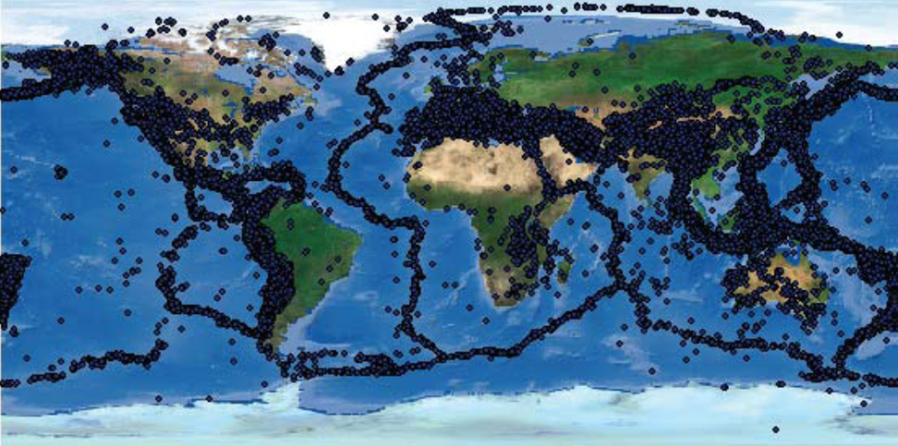
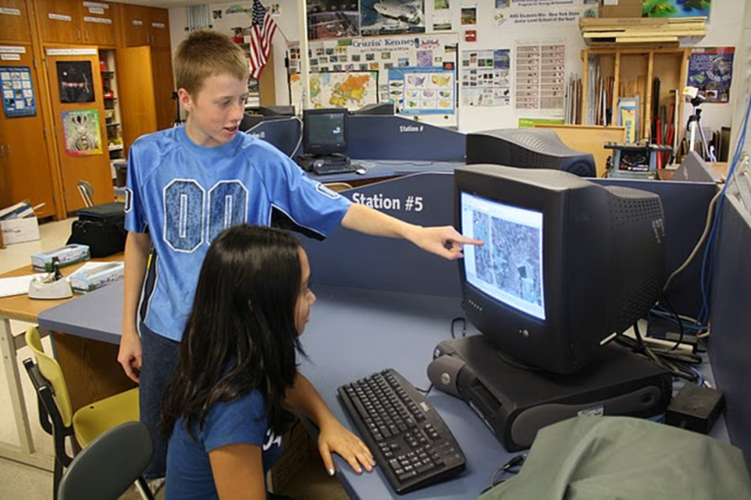
At work for you!
Education of youth / educators in GIS
Signed an agreement with Esri for K-12 Site License for New York State
Conducted 2 awareness webinars
Developing trainings that can be offered across NY
March 2012
Notes:
Awareness webinars = general awareness about 1) what is GIS; 2) how educators are currently using GIS to cover topics in the classroom (Language Arts, History, Science); 3) how educators are using GIS to engage students in community projects; and 4) some of the details of the NY Statewide license

Slide 14
At work for you!
Who’s eligible under the Esri Statewide License?
Under the contract, available to K–12 Schools (public and private) in New York State.
All public and non-public schools providing education in grades K-12, including charter schools, technical schools, magnet schools, Montessori schools, and religious schools.
Home schools
Local chapters of recognized national youth programs, including but not limited to 4-H, FFA, Boy Scouts, Girl Scouts, Boys and Girls Clubs; other youth-serving clubs.
March 2012
Notes:
Awareness webinars = general awareness about 1) what is GIS; 2) how educators are currently using GIS to cover topics in the classroom (Language Arts, History, Science); 3) how educators are using GIS to engage students in community projects; and 4) some of the details of the NY Statewide license

Slide 15
At work for you!
Requirements for K-12 to acquire software
Sign a Memorandum of Understanding (MOU)
Required Signatures:
Principal/Superintendent/Club leader
IT Administrator
Point of Contact
Demonstrate knowledge of GIS
Training
Partnership with GIS professional
March 2012
Notes:
Awareness webinars = general awareness about 1) what is GIS; 2) how educators are currently using GIS to cover topics in the classroom (Language Arts, History, Science); 3) how educators are using GIS to engage students in community projects; and 4) some of the details of the NY Statewide license

Slide 16
At work for you!
Website being developed
https://sites.google.com/site/nygisk12
Sign up to keep informed
Share with K-12 educators
FAQ’s
Events
Resources
ACCESS the MOU
Website Still Under Construction
March 2012
Notes:
Awareness webinars = general awareness about 1) what is GIS; 2) how educators are currently using GIS to cover topics in the classroom (Language Arts, History, Science); 3) how educators are using GIS to engage students in community projects; and 4) some of the details of the NY Statewide license

Slide 17
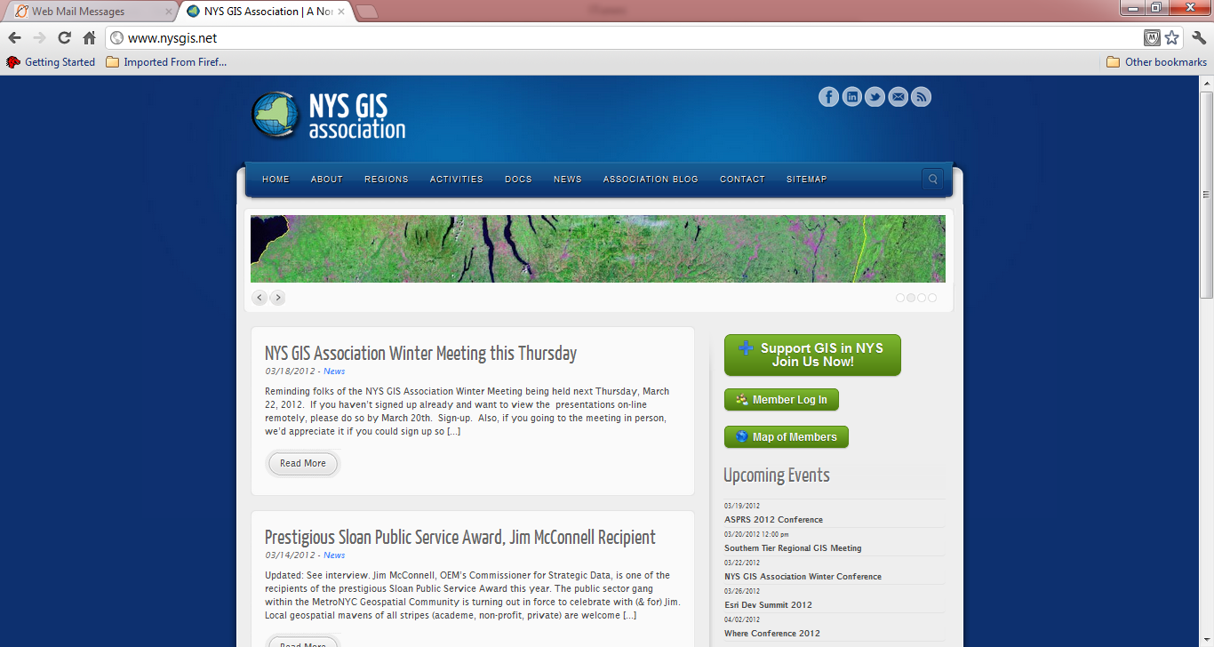
At work for you!
Providing a conduit for communication
NEW Association web site: www.nysgis.org
Regular updates
Find:
Meetings
Conferences
Training
Jobs
Calendar & more
March 2012

Slide 18
At work for you!
Stay Connected
News – updated often
Upcoming
Events
Twitter Feed
March 2012

Slide 19
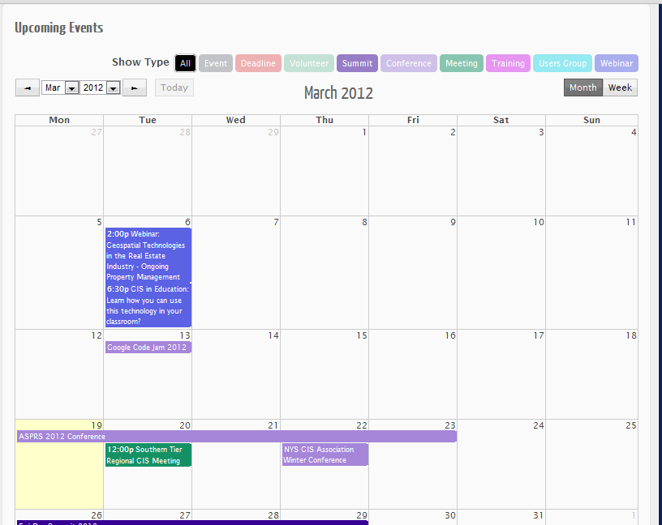
At work for you!
Calendar of Events
March 2012

Slide 20
At work for you!
Providing a conduit for communication
Twitter account: twitter.com/NYS_GISA
On our Twitter map yet?
Find yourself and watch us grow: http://bit.ly/fwyJEq!
March 2012

Slide 21
At work for you!
Providing a conduit for communication
Facebook page: http://www.facebook.com/NYSGISA
March 2012

Slide 22
At work for you!
Providing a conduit for communication
LinkedIn account (link on website)
RSS feed for addition to News items
March 2012

Slide 23
At work for you!
Providing a conduit for communication
Bi-annual newsletter:
March 2012

Slide 24
At work for you!
Plus an online membership database!
Profile & Participation
Am I a member?
March 2012

Slide 25
Agenda
8:30 – Registration/Coffee/Networking
9:00 – Welcome and Introductions
9:15 – Review of Association Activities:
2012 Proposed Surveying Legislation
Professional Development Activities
Conference Committee Updates
Implementing K-12 Education
Tour of new website
10:00 – Discussion on Assisting Members Looking for Jobs
10:15 – Coffee/Networking
10:30 – Presentation on Census Data by Bob Scardamalia
12:00 – Meeting Adjournment
March 2012

Slide 26
Jobs – Assisting Association Members!
Are people here looking for jobs?
Are there companies here looking to hire?
Where to look?
Website/Acitivites/Jobs: http://www.nysgis.net/activities/gitjobs (12 jobs posted since Feb 20th)
NYS GIS Twitter, Facebook, LinkedIn
List Serves: NYS GIS List Serve, GISMO: gismonyc@yahoogroups.com, PA List Serve: PaMAGIC@yahoogroups.com, VT List Serve: VGIS-L@list.uvm.edu, CT List Serve: CTGIS-L@listserv.uconn.edu
March 2012

Slide 27
Jobs – Assisting Association Members!
Webinar: Jobs in Geospatial Intelligence and the GEOINT Tradecraft – March 27th https://www2.gotomeeting.com/register/332350770
LinkedIn GIS/GPS Jobs – Group
Directions Daily Magazine – Jobs (Bottom of Page)
GIS Career Newsletter: gis_news_letter@giscafe.com
March 2012

Slide 28
Agenda
8:30 – Registration/Coffee/Networking
9:00 – Welcome and Introductions
9:15 – Review of Association Activities:
2012 Proposed Surveying Legislation
Professional Development Activities
Conference Committee Updates
Implementing K-12 Education
Tour of new website
10:00 – Discussion on Assisting Members Looking for Jobs
10:15 – Coffee/Networking
10:30 – Presentation on Census Data by Bob Scardamalia
12:00 – Meeting Adjournment
March 2012

Slide 29
Thank You!
NYS GIS
association
March 2012

